Slide 1



MIRZA: Efficiently Mitigating Rowhammer with Randomization and ALERT
Hritvik Taneja, Ali Hajiabadi, Michele Marazzi, Kaveh Razavi and Moinuddin Qureshi
Notes:
Work was done with Ali, Kaveh from ETH Zurich, Michele from ABB Research and my advisor Moin Qureshi from Georgia Tech

Slide 2


What is Rowhammer?
DRAM scaling increases inter-cell interference
Rowhammer Attack
DRAM
(old)
Row of Cells (4/8KB)
Aggressor Row
Row
Rapid
Accesses
Row
Victim Row
Aggressor Row
Row
DRAM
(new)
DRAM
Bit-Flips in Neighboring Rows
Software adversary can use Rowhammer to gain kernel privileges
Notes:
Rowhammer is a hardware vulnerability that has persisted for over a decade now.
As DRAM scales for higher capacity, cells are packed so closely that accessing one row causes charge leakage in neighboring rows.
** Rowhammer attacks exploit this phenomenon by accessing a DRAM row rapidly in a short window of time
This ends up causing bit-flips in neighboring rows.
** The row being rapidly activated is called an aggressor row and the row incurring bit flips is a called a victim row
** So, Rowhammer allows an adversarial software to flip bits in memory without accessing them.
This is a serious security threat
For example, an attacker can take over the system by flipping bits in the page table

Slide 3


Typical Rowhammer Defense
❶Track Aggressor Rows
❷Mitigative Action
RowID | ACT Count
#ACTs > TRH
Victim Row
Refresh
Aggressor Row
Victim Row
Memory Controller
In-DRAM
In-DRAM defense solves Rowhammer transparently within DRAM
Notes:
Mitigating Rowhammer consists of 2 parts, first tracking the aggressor rows
** And second performing the mitigative action of refreshing the neighboring victim rows
** Once the number of activations to a row breach a threshold which we call the Rowhammer threshold the RH defense perform a mitigative action
** Tracking can be done either at the MC or within the DRAM,
** The in-DRAM approach is appealing as it solves Rowhammer transparently within DRAM
So, in this work we will focus on in-DRAM RH defense

Slide 4
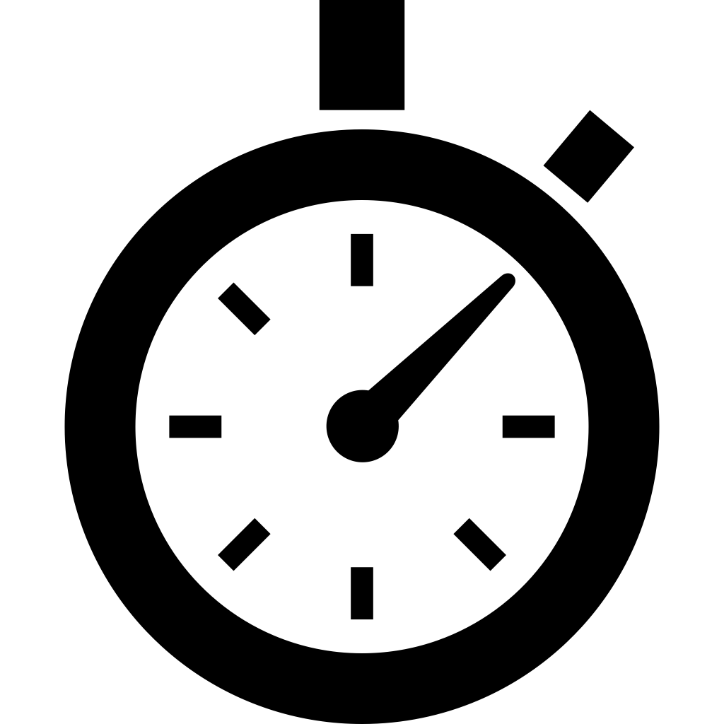


In-DRAM Rowhammer Defense
TRR deployed in DDR4/DDR5
❶Storage For Tracking
❷Time for Mitigation
❸Power for Victim Refresh
RowID | ACT Count
Broken by TRRespass, Phoenix
Insecure
In-DRAM defense should have low storage, time, and power overheads
Notes:
In-DRAM defense needs three resources: storage to track aggressor rows
**time to perform mitigations,
**power to perform mitigative refreshes.
**Ideally, we want all three to be low: low storage overhead,
Low time for mitigation so that we don’t take time away from demand requests,
and not too much power overhead for mitigative refreshes.
**In-DRAM Rowhammer solutions have already been deployed
DDR4/DDR5 already contain a tracker called Target Row Refresh or TRR
**But its not secure,
it tries to track only a small number of entries
And has been broken by attacks like TRRespass and Phoenix
So, both industry and academia have been developing principled trackers
Let me tell you about 2 state of the art approaches

Slide 5


MINT: Low Storage In-DRAM Tracker
MINT is a low-cost in-DRAM tracker which uses probabilistic sampling for tracking
A
B
C
D
TRH | W
500 | 24
1000 | 48
2000 | 96
URAND(0, W)=2
Mitig B
Window=W ACTs
Low Storage: 20B SRAM/Bank
At low thresholds MINT requires frequent mitigations
Notes:
First, MINT is a recently proposed design that minimizes storage by using probabilistic tracking
** Here's how it works: MINT defines a window of W activations
** And at the start of a window it decides a priori which of the W activations it is going to sample,
For example activation 2 gets sampled,
** at the end of the window the address corresponding activation 2 gets mitigated
** Now, Depending on the Rowhammer threshold, you can have a different window size
So, For example by probabilistically selecting an aggressor every 48 ACTs, MINT can tolerate a RH threshold of 1000
** The good thing about MINT is that it requires low storage overhead -- Around 20 bytes of SRAM per bank.
** However, at low thresholds, you need frequent mitigations -- For instance, at threshold of 1K, you mitigate once every 48 ACTs
and you can't just hide these mitigations inside normal refresh
Fortunately, DDR5 introduces a new interface called Refresh Management, or RFM, which explicitly provides time for Rowhammer mitigation.
Let's see how MINT uses RFM to perform these frequent mitigations

Slide 6
MINT + RFM: Time for Mitigation
Refresh Management (RFM) provides 350 ns to perform mitigations
Mitigate B
BankID
#ACTs
TRH | W
500 | 24
1000 | 48
2000 | 96
. . .
RFM
B
RFM
RFM
. . .
W ACTs
Memory Controller
High Mitigation Time Overhead
High Refresh Power Overhead
MINT minimizes storage but incurs high time and power overheads
Notes:
So RFM proactively provides time by issuing an RFM command after every N ACTs to bank
**Here's how it works: The memory controller tracks the number of activations per bank using a counter.
**When this counter reaches a threshold - let's say W activations - the memory controller issues an RFM command which stalls the memory system for 350 ns
**MINT uses the time to mitigate the sampled row - in this case, row B
Now RFM doesn't know whether you actually need mitigation.
**It’ll just blindly gives you time after the next W activations and so on..
So even if you're running a perfectly benign workload that's not hammering any rows,
RFM will proactively provide time for mitigation every W activations and stall your system.
**This leads to both high mitigation time overhead And high refresh power overhead
**So while MINT achieves low storage, it pays a heavy price in time and power due to these frequent proactive mitigations.
Now, let's look at another state-of-the-art tracker: PRAC+ABO.

Slide 7

PRAC + ABO
Per-Row Activation Counting (PRAC): In-lined counters, memory timing revised
ALERT-Back Off (ABO) Protocol: Allows DRAM to reactively get time for mitigation
DRAM Bank
C > TRH
180ns
350ns
Row
C
ALERT
Normal
tRFM
MC stops all operations
High Storage and Performance Overhead
Low Mitigation Time and Refresh Power Overhead
PRAC+ABO incurs 6.5% slowdown from timing changes
Notes:
To develop a secure tracker, the industry is moving towards a radically different design that provisions a counter with each row.
It's called PRAC, or Per-Row Activation Counting.
So now on every activation, you read-modify-write to increment this counter
This solves the tracking problem completely - because each row has its own counter, you can accurately track every single activation.
**They also solve the timing problem by giving DRAM the ability to ask for time as and when needed with a new protocol called Alert Backoff or ABO
The way ABO works is that
**When a row's counter exceeds the threshold, the DRAM raises the ALERT pin
**upon which, the memory controller responds by providing 350 ns for mitigation.
So now getting time is reactive – DRAM can ask for it when needed
**But the storage overhead of this per row counter is significant
On top of that to update these per row counters we need to change the DRAM timings
Which causes performance overhead of about 6.5%
**But The good thing about reactively asking for time is that because most rows never reach the RH threshold
So you almost never pay any mitigation time or refresh power overhead
In fact, for RH thresholds above 250, PRAC+ABO requires virtually no mitigations

Slide 8
Towards Low Storage, Time, and Power
Storage
Slowdown (%) for TRH=1000
Refresh Power Overhead (%)
MINT
Low
5.6%
8.2%
From frequent mitigations
PRAC
High
6.5%
0%
From updated DRAM timings
Goal: Enable low performance, storage and refresh power overhead tracker
Solution: MIRZA - Mitigating Rowhammer with Randomization and ALERT
Notes:
So, With MINT, we have low storage but high performance and power overhead from frequent mitigations.
** On the other hand With PRAC, we have high storage and performance overhead from timing changes, but low mitigation overhead
** Ideally, we want a design with low performance overhead, low storage, and low refresh power.
The goal of this work is to design such a practical tracker.
To that end, We propose MIRZA: Mitigating Rowhammer with Randomization and ALERT.

Slide 9

Reactive vs. Proactive Mitigation
Mitigation Type
Proactive - RFM
Reactive - ABO
RowID | Count
PRAC
Counters (costly)
Tracking Type
MINT
Probabilistic (low-cost)
What if we make MINT reactive?
Notes:
Broadly, there are two ways to get time for mitigation:
proactive with RFM, and reactive with ABO.
** And two types of trackers: counter based and probabilistic.
** MINT is a probabilistic tracker which gets time using RFM
** And PRAC is a counter-based tracker which has the ability to reactive ask for time using ABO
** Ideally, what we want is the low cost tracking of MINT
And the ability to reactively get time like PRAC
** So what if we just make MINT reactive?
[Transition] This leads us to the first insight of this work, which is to make MINT reactive using ABO

Slide 10
Insight #1: MINT+ABO
We make MINT reactive by using ABO to ask for time
ABO
ABO
ABO
. . .
. . .
RFM
RFM
RFM
W ACTs
Memory Controller
Replacing RFM (5.6%) with ABO (5.8%) incurs similar slowdown
Notes:
This leads us to the first insight of this work, which is to make MINT reactive using ABO
**Whenever MINT needs time, it asks for it using ABO
This might seem nice, but we find MINT+ABO has similar performance overhead to MINT+RFM.
**Why? Because you're still stalling every W activations,
whether the MC proactively gives you time using RFM or you ask for it reactively using ABO
** So simply replacing RFM with ABO doesn't help
But what we now have is a substrate that allows us to sometimes get time
And sometimes skip getting time
[Transition] This brings us to our second insight - coarse grained filtering

Slide 11
Insight #2: Coarse Grained Filtering
MINT is designed for worst-case access pattern, which results in frequent mitigations
Adversarial Pattern
Focused ACTs
Benign Workloads
Spread-Out ACTs
p=1/w
Rows
Rows
Prob. of Mitigation
Mitigations not needed
Mitigations via ABO
TRH
0
FTH
ACTs/(Regions of 1024 Rows)
With FTH=1500 99% ACTs skip mitigation
MIRZA uses filtering and ABO to minimize mitigation overheads
Notes:
This brings us to our second insight - coarse grained filtering
** Tracker like MINT are designed for worst-case patterns where the same row is accessed repeatedly.
** But that's not how typical workloads behave.
They actually spread out their activations to different rows
** If you look at a region of 1000 rows, the total number of times they get activated in a refresh interval of 32ms is actually quite small
Between 100 to 1500 times for a region of 1000 rows, compared to the worst case of 621K
**So if the activation counts of a region are almost always low, below the RH threshold, we don’t need to do any mitigations
**So what we could instead is that
is if the number of ACTs to a region is low, don’t do MINT, the probability of selection is zero
After the count reaches a particular filtering threshold then start doing MINT
** Infact for a FTH of 1500, we can skip mitigation for 99% of ACTs
** That’s our proposal with MIRZA, where we use CGF and reactive mitigation to minimize storage, slowdown and refresh power
The reason this works is that now we have a choice: we request mitigation time only when needed using ABO.
When we don't need it, there's no overhead.

Slide 12
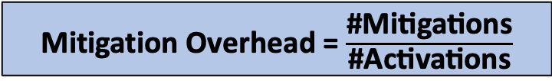
MIRZA: Design Overview
RCT
For TRHD=1K, budget of ACTs = 2000
RegionID
No
Ctr++ Done
Ctr > FTH?
99%
2000
ACT
Ctr
MINT (W=12)
Yes
1%
MINT (W=48)
Number of ACTs
CGF (FTH=1500)
MINT-W
Per Bank Queue
Issue ABO
Sampled RowID
MINT+ABO
MIRZA
Mitigation Overhead = $\frac{\text{\#}\text{Mitigations}}{\text{\#}\text{Activations}}$
Mitig. Overhead MINT+ABO= 1/48
Mitig. Overhead MIRZA = 1% x 1/12
MIRZA reduces the mitigation overhead of MINT by 25x
Notes:
Now let me walk you through the design of MIRZA
When an activation arrives, we first check the Region Count Table,
where each region tracks the number ACTs to a group of rows
If the counter is below the filtering threshold, we increment it and we're done - this is 99% of activations.
** For the remaining 1% of ACTs, when the counter exceeds FTH
We go to MINT for probabilistic selection
Now, What should be the window size for MINT?
**For a double-sided threshold of 1K, our total budget is 2000 activations per row.
** In MINT + ABO without filtering, MINT guarantees that a row will not exceed 2000 ACTs, by using a window size of 48
** But now with MIRZA, 1500 of that budget is consumed by filtering.
So MINT needs to guarantee that no row receives more than 500 ACTs
To handle that need to use a MINT window size of 12
** To understand the performance impact of MIRZA
lets define mitigation overhead as the ratio of number of mitigations to number of activations
** For MINT+ABO the mitigation overhead would be 1/48 since MINT will select a row every 48 ACTs
** However, for MIRZA, the mitigation overhead would be 1% times 1/12, equals 1/1200.
So even though in MIRZA we do more frequent mitigation once a group of rows cross the filtering threshold - We do them only 1% of the time
Thus, MIRZA reduces the Mitigation overhead of MINT by 25x

Slide 13
Slowdown of MIRZA
PRAC overhead is only from updated DRAM timings and not from ALERT
For TRHD=1K MIRZA incurs a slowdown of just 0.4% vs 6.5% of PRAC
Notes:
Now let's look at the performance impact of MIRZA.
The graph compares slowdown across three schemes: MINT+RFM, PRAC+ABO, and MIRZA at different thresholds.
MINT+RFM, has a slowdown of 11% at a threshold of 500
and the slowdown reduces as we increase threshold since the frequency of mitigations reduce
We observe that PRAC+ABO has a constant 6.5% slowdown,
Which comes entirely from increased memory timings.
Finally we can see that MIRZA outperform both PRAC+ABO and MINT+RFM
At a threshold of 1K, MIRZA incurs an average slowdown of just 0..4% as compared to 5.6 and 6.5% slowdown from MINT and PRAC

Slide 14
Impact of MIRZA on Refresh Power
Refresh Power Overhead = (Victim Refreshes / Demand Refreshes)
Reactive mitigations of MIRZA reduce the Refresh Power by 10-125x
Notes:
Next, let's look at the impact on refresh power.
We measure refresh power overhead as the ratio of victim refreshes to demand refreshes.
On the left, MINT with proactive mitigations incurs significant overhead
Up to 16% at a threshold of 500, and around 8% at threshold 1K.
On the right, MIRZA dramatically reduces this.
Because we only trigger mitigations when needed,
the overhead drops to less than 1% at threshold 1K.
Reactive mitigations of MIRZA reduce the refresh power by 10 to 125x.

Slide 15
Storage Overhead of MIRZA
Tracker | Storage (per-bank)
MIRZA-500 | 340
MIRZA-1K | 196
MIRZA-2K | 116
Secure Tracking? | Refresh Cannibalization
Yes | 0%
Yes | 0%
Yes | 0%
MIRZA-4.8K | 72 | Yes | 0%
TRR-4.8K | 84 | No | 17%
MINT-4.8K | 20 | Yes | 23%
Current Threshold
Deployed Mitigation in DD4
MIRZA requires only 196 bytes SRAM per bank at TRH=1K
Notes:
Here are the SRAM overhead of MIRZA at different threshold
At a threshold of 1K, MIRZA requires the SRAM budget is just 196 bytes per bank.
**So MIRZA provides secure mitigation with minimal storage and no refresh cannibalization
So far we've been talking about a threshold of 1K.
But what if someone wants to handle the current publicly available threshold of 4.8K?
**In that case, you can do filtering at a much coarser granularity
**which only consumes 72 bytes of SRAM per bank
**And this is even less overhead than the TRR mitigation deployed today in DDR4 devices which are insecure
**So, MIRZA requires very little SRAM overhead, making it practical for deployment.

Slide 16
Takeaways
First paper to enable low-cost, randomized, reactive in-DRAM Mitigation
ABO provides way for DRAM to reactively request time for mitigation
Just replacing RFM with ABO in MINT incurs similar slowdown
MIRZA uses Coarse-Grained Filtering to selectively use MINT
MIRZA has much lower slowdown than PRAC (0.4% vs. 6.5% at TRH=1K)
Much lower refresh power overhead 0.3% vs. 8.2% (MINT) at TRH=1K
Questions?
Notes:
To conclude, this is the first paper to enable low-cost, randomized, reactive in-DRAM mitigation.
ABO provides a way for DRAM to reactively request time for mitigation,
but simply replacing RFM with ABO in MINT doesn't reduce the slowdown — you still get frequent mitigations.
The key insight is to use Coarse-Grained Filtering to selectively invoke MINT only when needed.
With MIRZA we can achieve a slowdown of just 0.4% compared to 6.5% with PRAC at a threshold of 1K
And a much lower refresh power overhead of just 0.3% as compared to 8.2% of MINT
**Thank you for listening and I will now take any questions.

Slide 17
In-DRAM Rowhammer Defense
❶Storage For Tracking
❷Time for Mitigation
❸Power for Victim Refresh
RowID | ACT Count
How do we minimize these overhead?
In-DRAM defense should have low storage, time, and power overheads
Notes:
In-DRAM defense needs three resources:
storage to track aggressor rows
**time to perform mitigations,
**power to perform mitigative refreshes.
Ideally, we want all three to be low
low storage overhead,
Low time for mitigation so that we don’t take too much time taken away from demand requests,
and not too much power for mitigative refreshes.
** So how do we minimize these overheads?
Let's look at two state-of-the-art schemes.

Slide 18
MINT: Low Storage In-DRAM Tracker
MINT is a low-cost in-DRAM tracker which uses probabilistic sampling for tracking
A
B
C
D
TRHD | W
500 | 24
1000 | 48
2000 | 96
URAND(0, W)=2
Mitig B
Borrow Time from REF
Window=W ACTs
Refresh Management (RFM) command
Provides 350 ns for mitigation
High Time and Power Overheads
Low Storage: 20B SRAM/Bank
MINT minimizes storage but requires frequent proactive mitigations
Notes:
First, MINT is a recently proposed design that minimizes storage by using probabilistic tracking
** Here's how it works:
MINT defines a window of W activations
** And at the start of a window it decides a priori which of the W activations it is going to sample,
** For example activation 2 gets sampled, at the end of the window the address corresponding activation 2 gets mitigated
** Now to perform this mitigation You can either borrow time from REF,
Or if you need more frequent mitigations, you can use the RFM command introduced in DDR5
where the memory controller provides 350ns for mitigation after every N activations
*** Depending on the Rowhammer threshold, you can have a different window size
For a double-sided threshold of 1K, MINT requires a mitigation every 48 activations.
** So performing these frequent activations results in high time and power overheads
But the storage overhead of MINT is very low, it requires only 20 bytes of SRAM per bank.
Now, lets look at another SOTA tracker: PRAC+ABO.

Slide 19
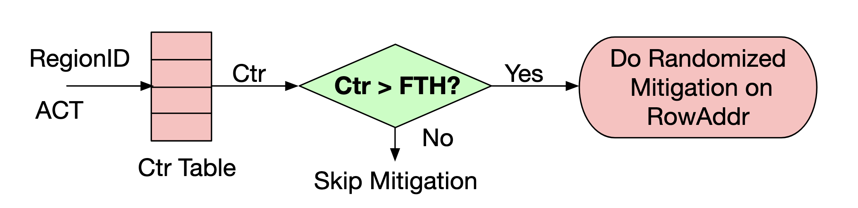
Insight #2: Coarse Grained Filtering
MINT is designed for worst-case access pattern, which results in frequent mitigations
Rows
Rows
Adversarial Pattern
Focused ACTs
Benign Workloads
Spread-Out ACTs
99% ACTs skip mitigation with FTH=1500
MIRZA uses filtering and ABO to minimize mitigation overheads
Notes:
This brings us to our second insight - coarse grained filtering
This leads us to the second insight of MIRZA
Which is to reduce the number of mitigations by using coarse grained filtering
So, Why are we doing mitigations all the time?
** Tracker like MINT are designed for worst-case patterns where the same row is accessed repeatedly.
But that's not how typical workloads behave.
** They actually spread out their activations to different rows
** If you look at a group of rows, the number of times they get activated in a refresh interval of 32ms is actually quite small
between 500-1500 times for a group of 1000 rows, compared to the worst case number of 621K
**So, Rather than having a counter per row, what if we had a counter per region consisting of 1000 rows? This saves storage
And For typical workloads, these counters won't reach a very high value
For these cases we don't really need any mitigations.
And if they cross a threshold, we can start doing mitigations using ABO
** Infact for a FTH of 1500, we can skip mitigation for 99% of ACTs
** That’s our proposal with MIRZA, where we use CGF and reactive mitigation to minimize storage, slowdown and refresh power
The reason this works is that now we have a choice: we request mitigation time only when needed using ABO.
When we don't need it, there's no overhead.

Slide 20
JEDEC Introduces PRAC+ABO
Per-Row Activation Counting (PRAC): In-lined counters, memory timing revised
ALERT-Back Off (ABO) Protocol: Allows DRAM to reactively get time for mitigation
DRAM Bank
C > TRH
180ns
350ns
Row
C
ALERT
Normal
tRFM
MC stops all operations
High Storage and Performance Overhead
Low Mitigation Time and Refresh Power Overhead
PRAC+ABO incurs 6.5% slowdown from timing changes
Notes:
PRAC+ABO is an emerging design that minimizes mitigations by allowing DRAM to reactively ask for time using ABO (the ALERT Back-Off protocol)
** PRAC specifies that each DRAM row now has an inline activation counter.
** Once a row’s counter crosses the TRH the Rowhammer threshold
** The DRAM raises an ALERT pin which indicates the MC to issue an RFM command so that DRAM can perform RH mitigations
But the storage overhead of this per row counter is significant
Infact for us to update these per row counter we need to change the DRAM timings
So each precharge requires RMW which increases DRAM time and causes performance overhead of about 6.5%
But The good thing about such a design is that
because you reactively ask for time for mitigation and most rows never reach a threshold of 1000,
So you don't pay any mitigation time or refresh power overhead
In fact, for RH thresholds above 250 PRAC+ABO requires virtually no mitigations

Slide 21
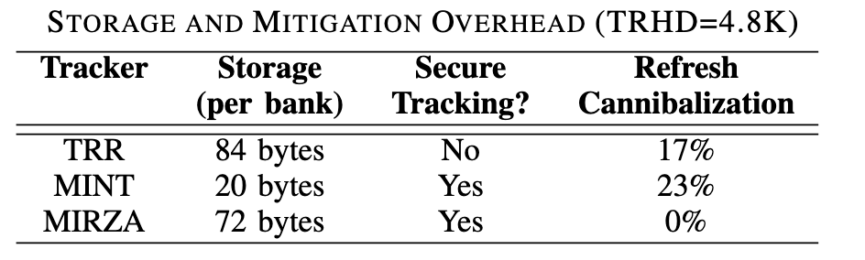
Storage Overhead at Current Threshold
Overheads at TRHD=4.8K (last publicly available TRHD)
In DDR4
MIRZA provides secure tracking with less overhead than TRR
Notes:
So far we've been talking about a threshold of 1K.
But what if someone wants to handle the current publicly available threshold of 4.8K?
In that case, you can do filtering at a much coarser granularity which only consumes 72 bytes of SRAM per bank
And this is even less overhead than the TRR designs deployed today which are insecure
And take time away from normal refresh

Slide 22
The Time Challenge
Memory Controller
Victim Row
Borrow Time from REF
Not Scalable
Refresh
Aggressor Row
Refresh Management (RFM) command
Provides 350 ns for mitigation
Victim Row
RFM provides time for mitigation without cannibalizing normal REF
Notes:
Because DRAM is a passive device
** The MC needs to provide DRAM time to perform the mitigative action
** Conventionally this is done by borrowing time from normal refresh,
** However this is not scalable, because with every new generation the reliability of DRAM itself if worsening and it needs more frequent refreshes
** So, DDR5 introduces a new Refresh management command which when issued provides DRAM 350 ns to perform RH mitigations to victim rows
So RFM allows in-DRAM trackers to perform mitigation without cannibalizing on normal refresh

Slide 23
MINT (tracking) + RFM (mitigation)
MC issues an RFM command (350 ns) after every N ACTs to a bank
MINT samples a row every W ACTs
TRHD | W
500 | 24
1000 | 48
2000 | 96
Slowdown
11.15%
5.6%
2.92%
A
B
C
D
URAND(0, W)=2
Mitig B
RFM
Window=W ACTs
Frequent RFMs with MINT result in high slowdowns
Notes:
The RFM interface works by configuring the MC to issue an RFM command every N activations to a bank
** MINT the low cost probabilistic tracker, exploits this interface by performing windowed sampling
MINT defines a window of W activations and configures the MC to issue an RFM every W activations
** And at the start of a window it decides a priori which of the W activations it is going to sample,
*** For example activation 2 gets sampled, at the end of the window the address corresponding activation 2 gets mitigated using RFM
*** Depending on the Rowhammer threshold, you can have a different window size
So MINT issues an RFM command which takes 350 ns every 24 to 96 ACTs
And and as you can imagine this can cause significant performance penalty
** Indeed we observe that the average slowdown for different thresholds is quite high
For example, at a threshold of 1000, the average slowdown is around 6%
Now lets understand why this is happening

Slide 24
Proactive Mitigations are Inefficient
MC proactively provides time for mitigations to DRAM
. . .
RFM
RFM
RFM
. . .
N ACTs
What if DRAM could reactively ask for time from MC when needed?
Memory Controller
RFM interface forces in-DRAM trackers to perform periodic mitigations
Notes:
With the RFM interface the MC proactively provides time for mitigations to DRAM
This interface of proactive mitigations from the MC forces the in-DRAM trackers to be designed in such a way that they have to perform periodic and frequent mitigations which results in high slowdowns
What if DRAM could reactively ask for time from the MC when it needs?
Indeed A recent proposal from JEDEC enables that

Slide 25
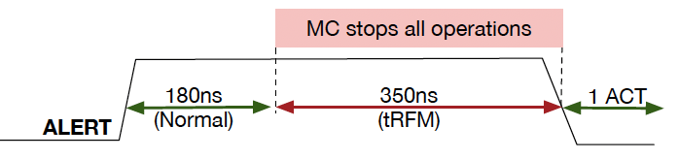
JEDEC Introduces PRAC+ABO
Per-Row Activation Counting (PRAC): In-lined counters, memory timing revised
ALERT-Back Off (ABO) Protocol: Allows DRAM to get reactively get time for mitigation
DRAM Bank
Row
C
Reactive nature of PRAC+ABO results in very few mitigations
Notes:
The PRAC+ABO framework allows for DRAM to reactively perform mitigations only when necessary
PRAC specifies that each DRAM row now has an inline activation counter.
Once a row’s counter crosses the TRH the Rowhammer threshold
The DRAM raises an ALERT pin which indicates the MC to issue an RFM command to perform RH mitigations
Recent implementations of the PRAC+ABO framework, such as MOAT and QPRAC, are highly effective. In fact, they require no mitigations for TRH >= 250.

Slide 26
The Problem with PRAC
Updating the inline counter increases PRE time
Read-B
Without PRAC
PRE
ACT-RowB
RD
Row-A Open
(14 ns)
(14 ns)
(12 ns)
Average Slowdown = 6.5%
Across SPEC-2017 and GAP workloads
Read-B
With PRAC
PRE
ACT-RowB
RD
Row-A Open
(36 ns)
(14 ns)
(12 ns)
Goal: Enable low-cost randomized trackers with reactive mitigation
Solution: MIRZA - Mitigating Rowhammer with Randomization and ALERT
PRAC+ABO results in high slowdown because of longer PRE duration
Notes:
However implementing PRAC requires modifying DRAM timing parameters
Normally, when DRAM needs to access a row that isn’t open, it first must
Close the row buffer, which requires a precharge that takes 14ns
Activate the row
And read it.
Overall, the time to read a conflicting row is 40ns
However, PRAC specifies that a precharge must also update a row’s counter. Now
Precharge latency increases to 36ns because DRAM must perform a read-modify-write on a row’s counter.
This also causes the time to read a conflicting row to increase to 62 ns
This 55% increase in the read latency causes an average slowdown of 6.5%
So the goal of this work is to enable a low cost randomized tracker which doesn’t encounter the overheads of PRAC or the SRAM cost of a counter based tracker

Slide 27
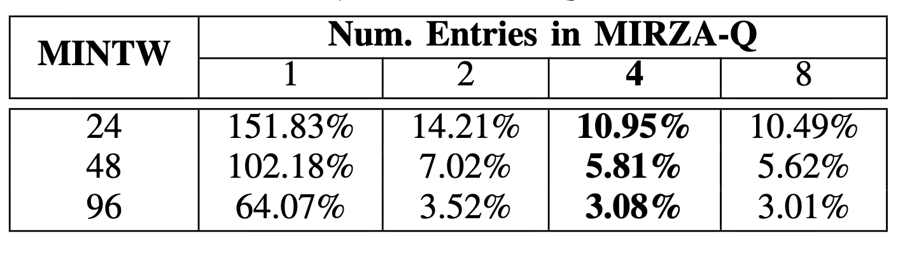
The Naive MIRZA Design: MINT+ABO
Replace proactive mitigation (using RFM) in MINT with reactive mitigation (using ABO)
BANK-0
Raise ALERT if MIRZA-Q is full
Or
Raise ALERT if Ctr > Q-TH
MIRZA-Q
Addr, Ctr
ABO
W ACTs
. .
Slowdown of Naïve MIRZA
BANK-N
MIRZA-Q
ABO
Addr, Ctr
W ACTs
MINT+ABO has similar slowdowns (5-15%)
Simply replacing RFM with ABO in MINT doesn’t reduce slowdown
Notes:
Our first step towards enabling MIRZA is to replace the proactive mitigations using RFM in MINT with reactive mitigations using ABO
In our design MINT first selects one address out of W activations to a bank and buffer it in a 4 entry MIRZA-Q
MIRZA-Q buffers the entries with a counter to track the number of activations received when buffered
if MIRZA-Q is full or if the queued entry exceeds QTH activations an ALERT is triggered (for mitigation)
When an ABO arrives each bank mitigates the row with the highest counter value
However we observe that the slowdown of naïve mirza is still very high
For a MIRZA-Q 4, the slowdown for MINT W 48 which corresponds to TRH of 1000, the slowdown is 5.8% which is similar to the 5.6% slowdown with RFM
So simply replacing RFM with ABO doesn’t reduce slowdowns

Slide 28
Insight: Coarse Grained Filtering (CGF)
Rows
Worst-case = 621K
Benign Workloads = 500-1500
Adversarial Pattern
Focused ACTs
ACTs/1K Rows in 32ms
Rows
MINT is designed for worst-case access pattern, frequent RFM/ABOs
Benign Workloads
Spread-Out ACTs
Track ACTs within a region, only invoke MINT if total ACTs exceeds FTH
Notes:
The key insight of DREAM is to reduce the number of mitigations to the DRAM by using coarse grained filtering
Our main observation is that adversarial patterns that are used to cause RH typically tend to focus their ACTs on a small set of rows
However, benign workloads typically spread out their activations to different rows
We measure this behavior by counting the total number of ACTs in 32ms to a group of 1K rows in a bank
We observe that for benign workloads the total number of acts to a group of 1K rows is actually between between 500-1500 ACTs
However, in the worst case the total number of ACTs to these 1K rows is 621K
Because MINT is designed to handle the MAX number of activations, it results in frequent mitigations that incur high slowdowns
So, we try to minimize the number of mitigations for the common case of benign workloads, where the number of ACTs to a row are significantly lower than the worst case
In our design MIRZA, we propose coarse grained activation tracking and filtering
Each bank in the DRAM maintains the count of number of ACTs to a region of rows
On every ACTs the in-DRAM tracker first check the region counter table,
if the activations in a region are below a filtering threshold, we skip mitigation
Otherwise, we forward to the row to participate in randomized mitigations
Our goal with this design is to skip most of the mitigations for benign workloads
However, The effectiveness of CGF depends on which set of rows we select in a region

Slide 29
Effectiveness of CGF
The RowID to RegionID mapping impacts the effectiveness of filtering
Region ID | Sequential Mapping | Strided Mapping
0 | RowID 0-1023 | RowID 0, 128, 256 . . .
1 | RowID 1024-2047 | RowID 1, 129, 257 . . .
2 | RowID 2048-3071 | RowID 2, 130, 258 . . .
.
.
FTH | Sequential Mapping (ACTs Filtered) | Strided Mapping (ACTs Filtered)
1400 | 5.16% | 98.34%
1500 | 5.55% | 99.12%
1600 | 5.94% | 99.62%
1700 | 6.31% | 99.85%
CGF with Strided Row2RegionID mapping can filter out 99% ACTs
Notes:
To understand this, we test 2 Row to region ID mappings
In Sequential mapping, we assign the same region ID to physically contiguous rows.
For example, the first 1K rows are assigned region ID 0, the second 1K rows region ID 1, and so on.
Whereas in Strided Mapping, we stripe consecutive rows across different region IDs.
So row 0 maps to region 0, row 1 maps to region 1, row 2 maps to region 2, and so on. Then row 128 wraps back to region 0, row 129 to region 1, and so forth.
The table on the right shows the filtering effectiveness for different filtering thresholds.
With Sequential mapping, only about 5-6% of activations get filtered
This is because spatial locality in workloads can concentrate accesses on a few contiguous rows, which all fall into the same region.
But with Strided mapping, we see a dramatic improvement. At a filtering threshold of 1500, we filter out over 99% of activations.
This happens because strided mapping spreads spatially local accesses across many different regions, so no single region accumulates too many activations.
So CGF with Strided Row-to-RegionID mapping can filter out 99% of ACTs, leaving only 1% to go through MINT-based probabilistic selection.

Slide 30
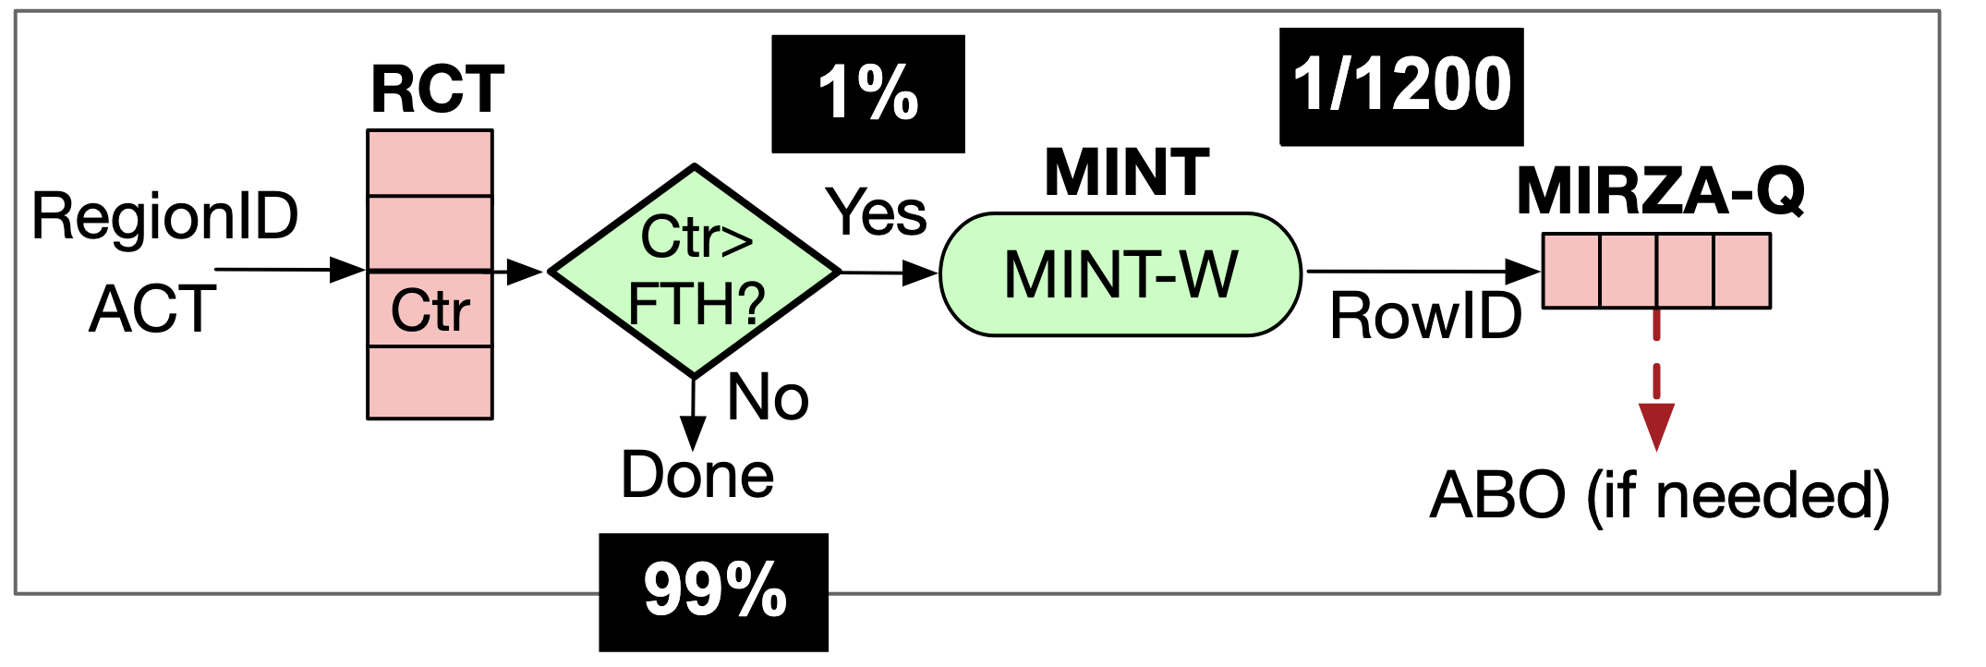
MIRZA: Design Overview
Naïve MIRZA: MINT-Window = 48 ACTs for TRHD=1000
MIRZA with CGF: FTH=1500 and MINT-Window = 12 ACTs for TRHD=1000
MIRZA reduces the probability of ACT selection from 1/48 to 1/1200
Notes:
Now let me walk you through the MIRZA design.
Without CGF, a naive MIRZA would need a MINT window of 48 activations to tolerate a threshold of 1000. This means one mitigation every 48 ACTs
But with CGF, we actually have to use a smaller MINT window of 12 activations. Why?
Because in the worst case, an attacker could target all the filtering threshold activations to just one row within a region.
So the filtering threshold consumes part of Rowhammer threshold,
And MINT has to handle the remaining budget with more frequent mitigations
1 out of every 12 activations that escape the filter.
But CGF is the saving grace here.
Even though MINT now mitigates more frequently,
CGF doesn't allow too many activations to reach MINT in the first place. 99% of activations are filtered out by the RCT and never participate in mitigation.
Here's how it works: When an activation arrives, we first look up the Region Count Table using the region ID.
If the counter is less than or equal to the filtering threshold, we increment the counter and we're done — 99% of activations take this path.
Only when the counter exceeds the filtering threshold does the activation proceed to MINT.
MINT performs its 1-in-12 selection, the selected row is buffered in MIRZA-Q, and an ABO is triggered only when needed.
So the effective mitigation rate becomes 1% times 1/12, which equals 1/1200. MIRZA reduces the probability of ACT selection from 1/48 to 1/1200.

Slide 31
Insight: Coarse Grained Filtering (CGF)
MINT is designed for worst-case access pattern, which results in frequent mitigations
Rows
Rows
Worst-case = 621K
Benign Workloads = 500-1500
Adversarial Pattern
Focused ACTs
Benign Workloads
Spread-Out ACTs
ACTs/1K Rows in 32ms
99% ACTs skip mitigation with FTH=1500
MIRZA uses filtering and ABO to minimize mitigation overheads
Notes:
This leads us to the key insight of MIRZA
Which is to reduce the number of mitigations by using coarse grained filtering
So, Why are we doing mitigations all the time?
** Tracker like MINT are designed for worst-case patterns where the same row is accessed repeatedly.
But that's not how typical workloads behave.
** They actually spread out their activations to different rows
** If you look at a group of rows, the number of times they get activated in a refresh interval of 32ms is actually quite small
between 500-1500 times for a group of 1000 rows, compared to the worst case number of 621K
**So, Rather than having a counter per row, what if we had a counter per region consisting of 1000 rows? This saves storage
And For typical workloads, these counters won't reach a very high value
For these cases we don't really need any mitigations.
And if they cross a threshold, we can start doing mitigations using ABO
** Infact for a FTH of 1500, we can skip mitigation for 99% of ACTs
** That’s our proposal with MIRZA, where we use CGF and reactive mitigation to minimize storage, slowdown and refresh power
The reason this works is that now we have a choice: we request mitigation time only when needed using ABO.
When we don't need it, there's no overhead.

Slide 32
Slowdown of MIRZA
For TRHD=1K MIRZA incurs a slowdown of just 0.36% vs 6.5% of PRAC
Notes:
Now let's look at the performance results.
The top graph shows normalized performance comparing PRAC+ABO against MIRZA at different thresholds.
The brown bars show PRAC+ABO slowdown for different threshold
We observe a constant value of 6.5% slowdown, which is entirely from increased memory timings.
MIRZA, shown in the colored bars, significantly outperforms PRAC across almost all workloads.
At a threshold of 1K, MIRZA incurs an average slowdown of just 0.36%.
The bottom graph shows ALERTs per 100 REF intervals.
PRAC triggers essentially zero ALERTs, so its slowdown is purely from timing overhead.
MIRZA triggers some ALERTs, but infrequently enough that overall performance impact remains very low.
For a threshold of 1K, MIRZA incurs just 0.36% slowdown versus 6.5% for PRAC.

Slide 33
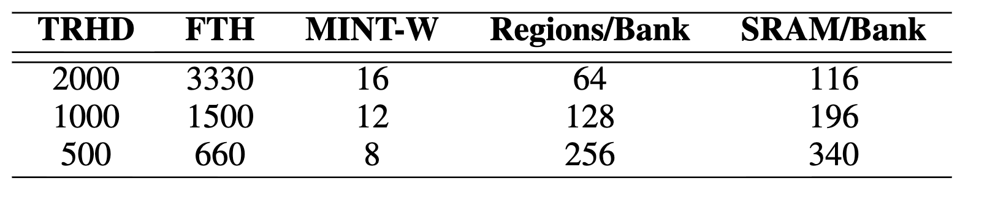
Area Overhead of MIRZA
Proposed configurations of MIRZA
SRAM Overhead at TRHD=4.8K (last publicly available TRHD)
MIRZA requires very little SRAM overheads making it practical
Notes:
Now let's look at the SRAM overhead of MIRZA.
The top table shows MIRZA configurations for different thresholds.
At a threshold of 1K, MIRZA requires a filtering threshold of 1500, a MINT window of 12, 128 regions per bank, and just 196 bytes of SRAM per bank.
The bottom table compares MIRZA against existing trackers at the last publicly available threshold of 4.8K.
TRR which is deployed in current systems uses 84 bytes but isn't secure.
MINT uses just 20 bytes and is secure, but as we discussed, it requires frequent proactive mitigations.
MIRZA uses 72 bytes, provides secure tracking, and enables efficient reactive mitigation.
MIRZA requires very little SRAM overhead, making it practical for deployment.
TODO: PRAC Overheads

Slide 34
Impact of MIRZA on Refresh Power
Mitigations require refreshing victim rows, consuming additional energy
Refresh Power Overhead = (Victim Refreshes / Demand Refreshes)
Reactive mitigations of MIRZA reduce the Refresh Power by 10-125x
Notes:
Finally, let's look at the impact on refresh power.
Mitigations require refreshing victim rows, which consumes additional energy. We measure this overhead as the ratio of victim refreshes to demand refreshes.
On the left, MINT with proactive mitigations incurs significant overhead
Up to 16% at a threshold of 500, and around 8% at threshold 1K.
On the right, MIRZA dramatically reduces this.
Because we only trigger mitigations when needed, the overhead drops to around 2% at threshold 500 and less than 1% at threshold 1K.
Reactive mitigations of MIRZA reduce the refresh power by 10 to 125x.

Slide 35
In-DRAM Rowhammer Defense
❶Track Aggressor Rows
❷Mitigative Action
RowID | ACT Count
Counter-Based
Probabilistic
Victim Row
ProTRR, Mithril
Refresh
Aggressor Row
PrIDE, MINT
Victim Row
100-1000s entries
1-4 entries
(costly SRAM)
(low SRAM cost)
Probabilistic trackers reduce the SRAM cost for tracking
Notes:
Tracking aggressor rows using counter can quickly become expensive
Even trackers like ProTRR and mithril which use optimal number of entries for a threshold, can require 1000s of entries
that's costly SRAM on the DRAM die.
** However, recently proposed tracker like MINT and PrIDE solve this problem by sampling rows probabilistically instead of keeping track of the number of activations to a row
And This reduces the number of tracker entries to between 1 and 4
** But tracking is only half the problem — to perform mitigations, DRAM also needs time.

Slide 36
Proactive vs. Reactive Mitigation
Proactive Mitigations
Reactive Mitigations
Memory Controller
Memory Controller
MC issues RFM even when not needed
MC only issues RFM when DRAM requests
ABO allows the in-DRAM tracker to communicate with the MC to request time when needed
Notes:
PRAC uses

