Slide 1

DREAM: Enabling Low-Overhead Rowhammer Mitigation via Directed Refresh Management
Hritvik Taneja and Moinuddin Qureshi
Notes:
Work was done with my advisor Moin Qureshi

Slide 2


Who should Solve Rowhammer?
Why MC-Side Mitigations?
DRAM Vendors?
SoC Vendors?
Avoid obscure/proprietary DRAM – TRR
Avoid slowdown of PRAC
Ensure security at low-cost in SOC
TRR?
PRAC?
MC-based RH mitigation enables SoC vendors to ensure security
Notes:
You’ve heard a lot about Rowhammer, but who should solve Rowhammer
*** DRAM vendors have tried; they developed TRR, but TRR was broken
Now, they are taking about PRAC, but PRAC has very high overheads
*** What about the SoC Vendors?
If SoC vendors can do it, you don’t have to rely on obscure solutions that DRAM industry is coming up with
You don’t have to pay the overheads of PRAC
*** So, MC-based Rowhammer mitigations allows SoC vendors to take matters into their own hand
And this is what we are going to talk about
So, how do we solve Rowhammer at the MC-level?

Slide 3


How to Solve Rowhammer at the MC?
PARA: Sample Randomly
Victim Row
Row X-1
ACT
Mitigate
ACT+PRE
Aggressor Row
Row X
Victim Row
Row X+1
TRH | “p”
1000 | 1/50
2000 | 1/100
4000 | 1/200
Memory Controller
Probabilistic tracking offers low storage overhead solution
Notes:
Memory-side mitigations consists of 2 parts, first identifying the aggressor row
And you can do that randomly, for example on an activation, select an aggressor with probability p
*** You can tune to value of p to tolerate different Rowhammer thresholds
*** After you have identified an aggressor, what you need to do is mitigation
And mitigation can be done by refreshing the neighboring rows
For example, for a row X – you refresh row X+1 and row X-1

Slide 4

Needed Support from Memory Interface
DRAM chips can scramble address internally, MC does not know neighbors
Victim Row
Row X-1
ACT
Mitigate
ACT+PRE
Aggressor Row
Row X
Victim Row
Row X+1
Memory Controller
Victim Row
Row Y
NRR
Aggressor Row
Row X
Nearby Row Refresh
Victim Row
Row Z
Prior MC-side studies assume NRR-like command (per bank)
Notes:
However, this refreshing of row X+1 and X-1 doesn’t work in real life
DRAMs internally scramble row addresses, so the memory controller does not actually know the physical neighbors of a given row
*** To solve this problem prior work assumed the presence of an NRR like command which would refresh the physical neighbors of a given row
And it is important to note that this NRR command was assumed to be a per bank command

Slide 5

DRFM: DDR5 Support for Mitigation
Memory Controller
Pre+Sample
DRFMab ➔ all banks (32 banks stall)
DRFMsb ➔ same bank in each bank-group (8 banks stall)
DAR
DRFM
DRAM Banks
Mitigate?
ACT
RD
Pre+S
DRFM
1
2
3
DRFM stalls 8-32 banks for each mitigation, performance impact?
Notes:
To support MC-side mitigations DDR5 actually introduced a new command called DRFM
DRFM has 2 parts, first a mechanism to sample a row into the DRAM and second a command that actually does mitigation for the sampled
*** So, lets look at how do you sample?
To sample you send a special precharge command, which populates the DRFM address register or DAR
Next, to do a mitigation you send a DRFM command, which can be of 2 types
*** DRFMab, which mitigates the DAR of all the 32 banks
And DRFMsb, which mitigates the DAR of 8 banks across all the bankgroups
Unlike NRR, DRFM stalls either 8 or 32 banks
And as you can imagine this could cause a significant performance penalty

Slide 6
Slowdown from DRFM
Replacing NRR with DRFM causes significant slowdown!
Notes:
Indeed, we observe a significant slowdown
**For example, at current thresholds of 4K, if you implement PARA with NRR you get 2% slowdown,
With DRFMsb the slowdown goes up to 7% and with DRFMab the slowdown goes to 28%
So, DRFM causes significant slowdown
Now, lets understand why this is happening

Slide 7
RLP: Rowhammer Mitigation-Level Parallelism
For DRFMsb, the maximum RLP is 8 (as 8 banks can mitigate)
Root Cause of Poor Performance with DRFM
Goal: Enable low-overhead MC-side mitigations by leveraging DRFM
Solution: DREAM – DRFM Aware Rowhammer Mitigation
Notes:
Recall that when a DRFMsb is issued it stalls 8 banks
At that time ideally we would like all the 8 banks to mitigate something
Let’s define metric called Rowhammer mitigation level parallelism or RLP, which captures this and counts the number of banks that mitigate something when a DRFM is issued
For DRFMsb, the maximum value of RLP is 8
*** However, for PARA we observe that only 1 bank mitigates something on average
Why? Because you sample a row and issue a mitigation, and it is very unlikely that other banks will have something to mitigate
*** This low RLP results in more frequent DRFMs because every bank will send DRFM only for themselves, causing the other 7 banks to stall.
So, if we can improve Rowhammer parallelism, we can reduce the number of times a stall happens
*** So, how do we improve RLP?
To do that we propose DREAM: DRFM aware Rowhammer mitigation

Slide 8
Insight: Delaying DRFM
BANK 1
Pre+S
BANK 2
Pre+S
BANK 3
Pre+S
Combined Mitigation
Mitigate?
ACT
RD
Pre+S
DRFM
1
2
3
How long should we delay?
BANK 1
BANK 2
BANK 3
Delay until the next sampled row to the same bank
Delaying DRFM to give other banks chance to sample into DAR
Notes:
The key insight of DREAM is to increase the RLP, by delaying the issue of DRFM
Our main observation is that you do not have to issue a DRFM right after sampling
*** You can infact delay the issue of DRFM
*** This allows other sibling banks to catchup and, also sample something into their DAR
*** And then you issue a DRFM, allowing multiple banks to participate in a combined mitigation
*** How long can we delay the DRFM? Untill the next time you need to sample something
Because remember when the DAR register is already filled, and we can’t overwrite it
We have to perform a mitigation first
*** So, in our proposal DREAM we delay DRFM to improve the RLP of PARA
However, delaying can have security implications,

Slide 9
Security Impact of Delaying DRFM
Delay
Mitigate
Pre+S
DRFM
DRFM
X Acts
Y Acts
For Security X+Y < TRHD
Insight: Proactively Limit Impact of Delay
Count activations the sampled row
Issue DRFM if count > 10
Naïve:
15% higher TRHD
Monitoring of ACTs to sampled row minimizes impact on TRHD
Notes:
Delaying can have security implications,
For example, the existing security model of PARA assume that you issue a mitigation right after sampling
***But when when we delay an attacker can use the extra time to cause more activations to the aggressor row
***We analyze the impact of delaying by accounting for both the time till sampling and the time between sampling and mitigation
Our analysis shows that delaying can have around 15% impact on the threshold
One way to solve this is to revise the tracker
***However, we came up with a second solution that is lower cost and doesn’t impact the threshold
We keep track of the number of activations to the sampled row since DAR sampling, and issue a mitigation if it crosses a small value lets say 10
***This limits the impact of delaying the threshold, and this is what we do
So, what does delaying buy us in terms of RLP and performance?

Slide 10
PARA+DREAM: RLP and Slowdown
Can we do better?
PARA+DREAM improves RLP to 3.2 and has similar slowdown as NRR
Notes:
PARA with DRFMsb had an RLP of 1, our solution increases it to 3.2
*** This reduces the slowdown of PARA from 6.7% to 2.1%, for current thresholds of 4K, making it similar to NRR
*** You may notice that the RLP is only 3.2 there is still a gap between the RLP achieved by PARA and the ideal value of 8
Can we bridge this gap?
To do that, the next design that we analyzed is a recent tracker MINT

Slide 11
MINT: Minimalist Tracker (URAND)
A
B
C
D
TRH | p | W
1000 | 1/50 | 50
2000 | 1/100 | 100
4000 | 1/200 | 200
URAND(0, W)=2
Mitig B
Window=W ACTs
MINT performs URAND selection
PARA and MINT selects row with same prob but different methods
Notes:
The next design we analyzed a recent tracker MINT
Unlike PARA which selects each and every activation with an identical and independent probability or IID probability
MINT does windowed sampling, it defines a window of W activations,
*** And at the start of a window it decides a priori which of the W slots it is going to sample,
*** For example slot 2 gets sampled, at the end of the window the address corresponding slot 2 gets mitigated
*** Depending on the threshold, you can have a different window size
So PARA and MINT both sample uniformly, but they sample using different methods, instead of IID, with MINT you use URAND
One important thing to note here is that, a mitigation should not reveal which item was selected
For example, if we issue a mitigation right after B, you can use a timing channel to figure out that B was mitigated and focus the attack on C and D
So it is important that you perform the mitigation at the end of the window
And our implementation does that

Slide 12
MINT with DREAM
Need to design MC-Side MINT carefully to avoid side-channels that leak selection
MINT-Reg
ACT Pre+S
DRFM
MC-Side MINT
Y
Window=W ACTs
Fill DAR
DAR
MINT-Reg
DRFM
ACT Pre+S
DREAM
X
Y
Window=W ACTs
Window=W ACTs
MINT-Reg → DAR
MINT with DREAM delays DRFM while maintaining security
Notes:
Within window when a memory controller identifies an aggressor, it stores it into a register at the memory controller called MINT-Reg
When the window finishes, the MC issues an extra ACT and PRE to sample this address into the DRFM address register, first
Then you issue a DRFM
*** Now for DREAM, we observe that we can directly sample into the DAR when DAR is invalid, because sampling does not create a timing side channel, only mitigation does
And that is what we do, if the DAR is free instead of writing to the MC-side register we directly sample into the DAR
*** In the next window however, when the DAR is busy you write the sampled address to the MINT register like before
*** And at the end of the window, you first issue a DFRM to clear the previous entry from DAR
And then you sample the MINT-Register into the DAR by issuing a ACT and PRE
*** This allows more time between sampling and issuing of DRFM
And this is how we implement DRFM-aware MINT, which tries to maximize the RLP
Great so how does MINT compare with PARA?

Slide 13
DREAM: PARA vs. MINT Slowdown
DREAM with MINT increases the RLP to 7.55 on average
Notes:
Great so how does MINT compare with PARA?
MINT increases the RLP to 7.55 on average as compared to 3.2 for PARA
Remember the maximum value of RLP for DRFMsb is 8
*** And, This reduces the slowdown of MINT to just around 1%, for current thresholds of 4K
We have had multiple talks in session about PRAC, how does DREAM compare with PRAC?

Slide 14
What about PRAC?
PRAC increases the memory timings (tRP, tRC) and causes high slowdowns
(slowdowns incurred regardless of TRH – 1K to 4K)
DRFM based mitigation are appealing versus PRAC at current TRH
Notes:
We have had multiple talks in session talk about PRAC, how does DREAM compare with PRAC?
While PRAC is a principled solution, the problem with PRAC is that it increases memory latency
Even at current thresholds of 4K, it has high latency overheads of around 10%
Comparatively, MC-side MINT has only 1% slowdown
So, DRFM based mitigations are quite appealing compared to PRAC
And SoC vendors might want to implement it
In this talk we have primarily focused on low-cost randomized trackers,
*** However, in the paper we have also analyzed how we can leverage the properties of DRFM to reduce the storage overheads of counter-based trackers

Slide 15
DRFM-Aware Counter-Based Trackers
Randomized Grouping
See the paper for more details
Notes:
In this talk we have primarily focused on low-cost randomized trackers,
However, in the paper we have also analyzed how we can leverage the properties of DRFM to reduce the storage overheads of counter-based trackers
Currently counter based trackers are designed at a per bank granularity,
But, DRFM allows you mitigate aggressors from multiple banks in parallel, infact with DRFMab you can mitigate 32 banks in parallel
*** If that’s the case, then you can keep a single counter for all the 32 banks, you don’t need a per bank tracker
This reduces the number of entries in the tracker by a lot, and this is what we have analyzed
One problem that we encounter is that all the cachelines in an OS page typically have the same RowID
*** So, if we share the counter amongst rows with the same Row ID, it results in hot counter, which triggers DRFM frequently and results in high slowdowns
*** We avoid this, by ensuring that rows sharing a counter, come from randomized location
*** We compare our DRFM based solution with the recent state-of-the-art abacus tracker
And we show that a DRFM-aware counter based tracker can reduce the storage overhead by around 3x to 6x
I encourage you to look at the paper

Slide 16
Takeaways
First paper to analyze DRFM for MC-side mitigations
DRFM stalls 8-32 banks per mitigation, high overheads
DREAM: Increases RLP by delaying issue of DRFM after sampling
PARA+DREAM has slowdown similar to NRR, MINT half as much
DREAM has much lower slowdown than PRAC (1% vs. 10% at TRH=4K)
Questions?
Notes:
To conclude, this is the first paper to analyze DRFM for MC-side mitigations
The problem with DRFM is that it can stall 8 or 32 banks and which causes high slowdown
We show that if you can make memory side mitigation DRFM-aware, then you can significantly reduce the slowdown
The reason why MC side mitigations are appealing even in the presence of PRAC is that
we can get a slowdown of just 1% instead of 10% with PRAC at current thresholds
*** Thank you for listening and I will now take any questions.
PRAC needs storage and it is an optional feature for DDR5 specs, it not mandatory, so DRAM vendors might not implement it, the DDR6 specs have not come out yet
Abacus doesn’t have randomization, so to make updates efficient it requires a bit vector, the cost of a bit vector is 32 bits, the cost for a shared counter that we use is 8 bits
Graphene is not secure beyond 700K, if you have a tracker across 32 banks, you can easily exceed that, if you exceed, you either refresh the entire memory (4ms), or issue a DFRM before serving every request

Slide 17
Backup Slides

Slide 18
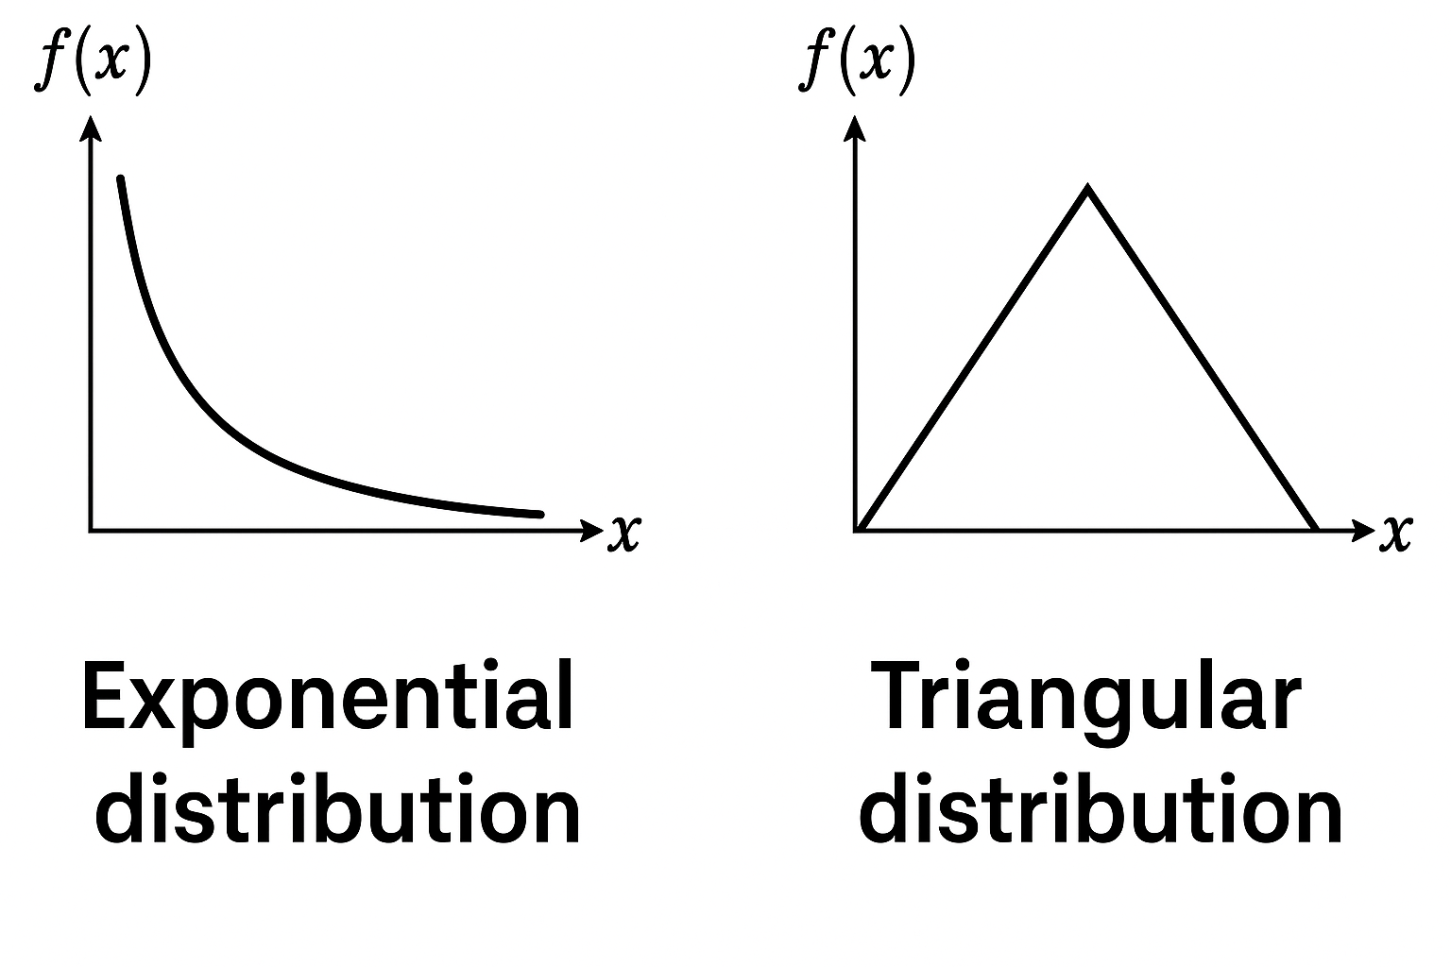
Inter-Selection Distance
Consecutive samples to the same bank – Poor RLP
Well spaced-out activations
MINT has well spaced-out samples, allowing better RLP
Notes:
Hard to explain

Slide 19
MC-Side MINT
A
B
C
D
ACT Pre+S
Explicit Sampling
Mitig B
URAND(0, W)
Coupled Mitigation
Fill DAR
Window=W ACTs
Is the no extra ACT/Pre+S the only thing that is better about decoupling?
A
B
Pre+S
C
D
Mitig B
Implicit Sampling
URAND(0, W)
Fill DAR
Decoupled Mitigation
Window=W ACTs
MC-side MINT can either have coupled sampling/mitig. or decoupled sampling/mitig.
Notes:
The cost of explicitly filling the DAR is gpoing to be more expensive than implicit sampling, but is that it?

Slide 20
MINT: DREAM-R vs. NRR
Bank 0
Bank 1
Bank 2
Bank 3
4 NRRs individually blocking 4 banks
1 DRFMsb blocking all the 4 banks together
The higher overall block time, results in a greater number of core stalls
MINT (DREAM-R) is better than NRR because of the RLP of DRFM

Slide 21
Implicit/Decoupled vs DREAM-R
A/B/C
D
E/G
F/H
Implicit/Decoupled
DRFM
DRFM
DRFM
DRFM
Bank 0
A
E
Bank 1
B
F
Bank 2
C
G
Bank 3
D
H
DRFM
DRFM
DREAM-R
A/B/C/D
E/F/G/H
DREAM-R has better RLP then Implicit Sampling and Decoupled Mitigations

Slide 22
Explicit/Coupled vs Implicit/Decoupled
Explicit/Coupled
DRFM
DRFM
DRFM
DRFM
Bank 0
A
Bank 1
B
Bank 2
C
Bank 3
D
DRFM
DRFM
Implicit/Decoupled
A/B/D
C
Implicit Sampling and Decoupled Mitigations has better RLP
Notes:
Lets look at a simple 4 bank example
The yellow bars indicate the MINT window, since the requests are evenly spread across different banks the windows overlap
With explicit sampling, we will issue 4 DRFMs and with implcity and decoupled we will only issue 2 DRFM
Let look at ghe actual RLP of both these methods

Slide 23


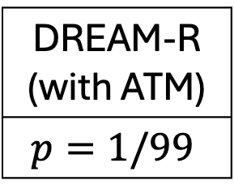
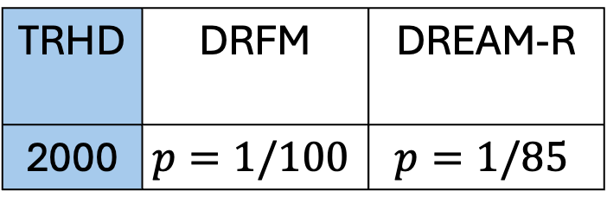
DREAM-R: Impact on TRH
For Security X+Y < TRHD
Delay
Mitigate
Sample
DRFM
X Acts
Y Acts
DRFMsb
DREAM-R
$$Pr\left(X>T\right)={\left(1−p\right)}^{T}=e^{−pT}$$
$$Pr\left(X+Y>T\right)=\left(1+p⋅T\right)⋅e^{−pT}$$
Exponential Distribution
Gamma Distribution
ATM: Active Target Row Monitoring
TRHD | DRFM | DREAM-R
2000 | $$p=1/100$$ | $$p=1/85$$
DREAM-R (with ATM)
$$p=1/99$$
Memory Controller
Row ID
Count
DREAM-R adjusts the parameters to keep the same TRH as DRFM with no delay

Slide 24
DREAM-C: Vertical Sharing
DCT
DCT
Issue 2xDRFMab
0
1
…
31
0
1
…
31
The number of counters for different TRH are the same
2x less counters for 2x TRH
The storage overhead for DREAM-C can be further reduced by vertically sharing the counter

